Slide 1
GRTC Development & Finance Committee| Legislative Update
Joe Dillard Jr., Director of External & Government Affairs
September 9 & 10, 2026

Slide 2
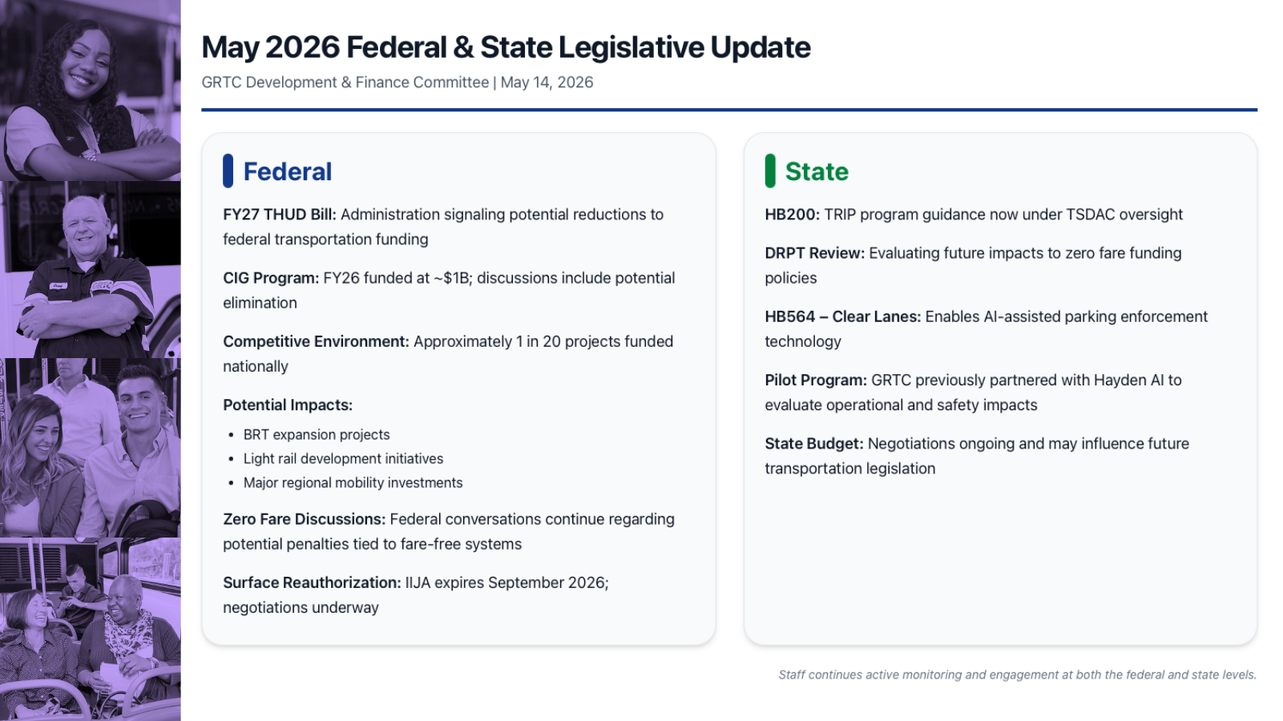
September 2026 Federal Legislative Update
GRTC Development & Finance Committees | September 9 & 10, 2026
Federal
Continuing Resolution: Congress passed H.R. 6500, extending federal surface transportation programs through December 11. This prevents the September 30 authorization sunset from interrupting formula and program funding while long-term reauthorization remains unresolved.
House Framework: The bipartisan BUILD America 250 Act remains the House vehicle for a five-year surface transportation reauthorization, with continued transit investment and an emphasis on project delivery, safety, and state flexibility.
Senate / CIG: The Senate has not released a full surface reauthorization counterpart. CIG remains central to GRTC's future BRT expansion, making continued advocacy on eligibility and funding levels important during negotiations.
GRTC Bus Priorities: Protect formula funding; maintain Bus & Bus Facilities and Low-No funding; preserve CIG eligibility for BRT; support flexible capital and safety funding; and avoid policies that disadvantage fare-free systems.
Next Steps: The December 11 extension creates additional time for House and Senate negotiations but does not resolve the long-term bill. GRTC should continue coordinating with the delegation and national transit partners before the next deadline.
Bottom Line: Near-term federal funding is protected, but the long-term reauthorization package—and its treatment of transit—remains the key decision point.
Notes:
[Sources]
- https://transportation.house.gov/news/documentsingle.aspx?DocumentID=410255
- https://transportation.house.gov/surface-transportation-reauthorization/
[/Sources]

Slide 3
September 2026 State Legislative Update
GRTC Development & Finance Committees | September 9 & 10, 2026
State
MERIT Public Comment: DRPT is accepting comments on proposed MERIT operating and capital assistance changes, along with TRIP revisions, through 5:00 p.m. on September 18.
Operating Formula: The proposed FY28 approach weighs agency size using 35% operating cost, 35% ridership, 15% revenue hours, and 15% revenue miles, increasing the role of ridership in allocation decisions.
Performance Weighting: The proposed set-aside uses 50% passengers per dollar, 25% passengers per revenue hour, and 25% passengers per revenue mile—placing greater emphasis on productivity and efficiency.
Capital Changes: DRPT recommends clearer project categories, a consistent method for vehicle expansion requests, fewer outdated incentive points, and added credit for strong grants management.
HB564 – Clear Lanes: GRTC continues developing the enforcement model, revenue assumptions, local partnerships, and potential pilot approach for a tool that could provide recurring support for zero-fare service.
Bottom Line: The immediate state priority is submitting a clear GRTC position before the September 18 comment deadline and preparing for the proposed FY28 formula changes.
Notes:
[Sources]
- https://drpt.virginia.gov/transit-service-delivery-advisory-committee-tsdac/
[/Sources]

Slide 4
September 2026 Local Legislative Update
GRTC Development & Finance Committees | September 9 & 10, 2026
Local
Richmond Council Calendar: City Council resumes its regular formal meeting schedule in September following the August recess, creating the next window for transit related coordination and actions through its Land Use & Transportation Committee.
Downtown Transfer Station: The City and GRTC are completing a safety review and targeted improvements during the August 31–September 11 closure, with routes operating from nearby temporary locations.
Permanent Downtown Hub: The City and GRTC continue advancing the permanent 10-bay transfer hub and mixed-use overbuild, with developer selection and negotiations targeted for completion by the end of 2026.
Bottom Line: Local attention remains centered on safe downtown operations, advancing the permanent hub, and sustaining regional service partnerships and funding commitments.
Notes:
[Sources]
- https://rva.gov/office-city-clerk/council-meetings
- https://rva.gov/press-releases-and-announcements-public-works/news/statement-richmond-department-transportation
- https://rva.gov/press-releases-and-announcements/news/city-richmond-and-grtc-launch-developer-solicitation-downtown
- https://rva.gov/press-releases-and-announcements-public-works/news/city-launches-public-surveys-newly-proposed
- https://www.chesterfield.gov/DocumentCenter/View/46948/FY2027-Proposed-Budget-and-FY2027-FY2031-Capital-Improvement-Program-PDF
[/Sources]

