Slide 1
GRTC Finance Committee| Legislative Update
Joe Dillard Jr., Director of External & Government Affairs
August 11, 2026

Slide 2
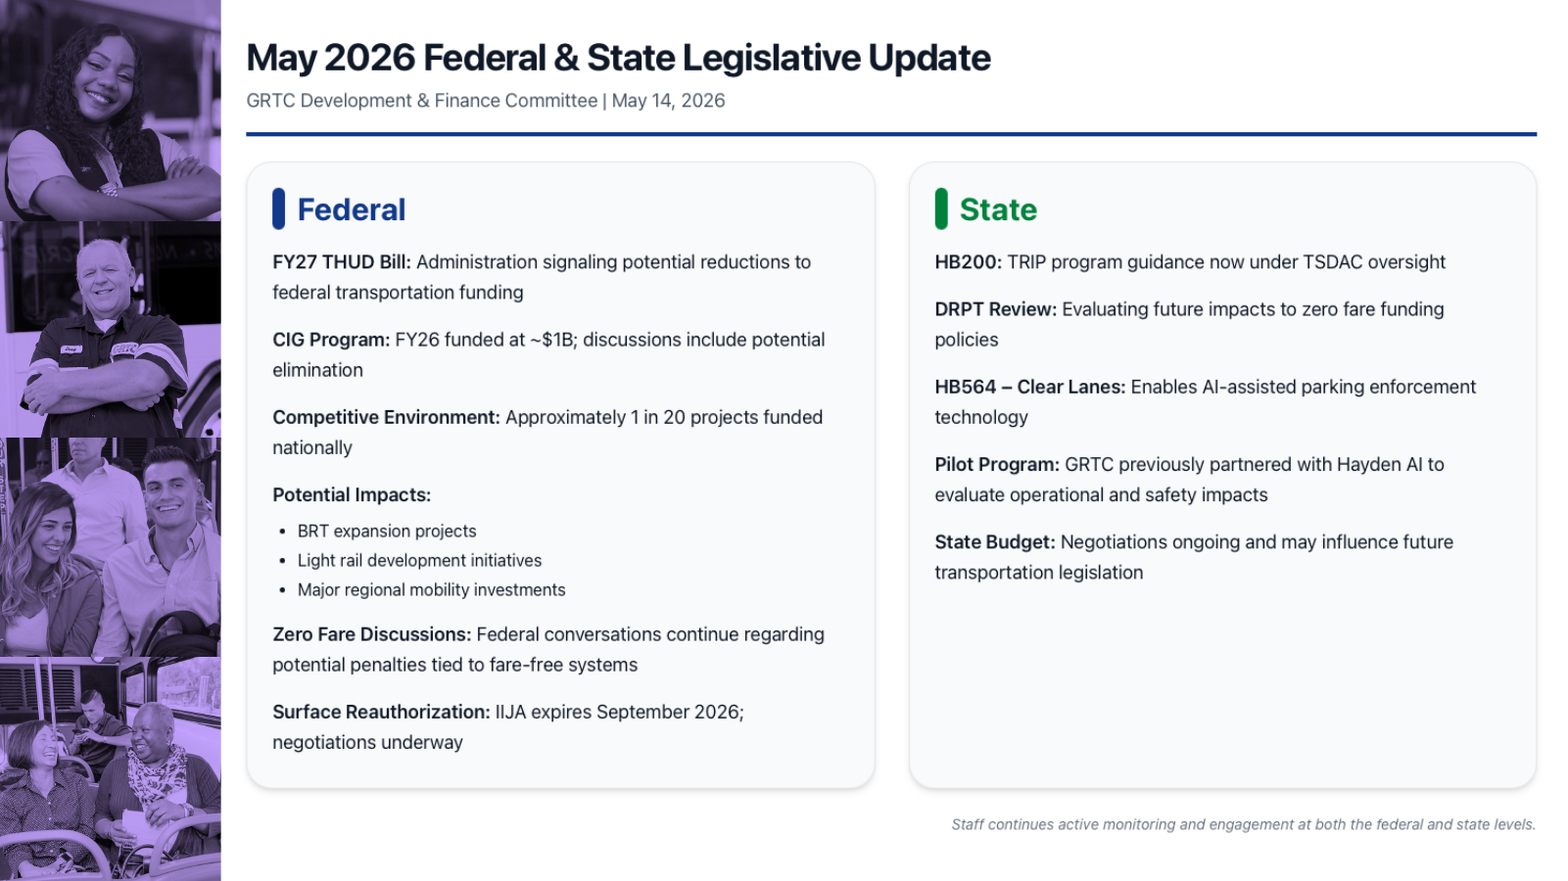
August 2026 Federal Legislative Update
GRTC Development & Finance Committees | August 11, 2026
Federal
Reauthorization Timing: The Senate has approved a stopgap through December 11. House action is still required. The timing pushes the major federal funding debate beyond the November elections; a further extension into January 2027 is possible if control of Congress shifts.
House Framework: The bipartisan BUILD America 250 Act preserves roughly $87.5B in guaranteed transit funding over five years, while emphasizing core infrastructure, faster project delivery, safety, and state flexibility.
Senate / CIG: The Senate has not released a full surface reauthorization counterpart. On appropriations, it has been more protective of transit: FY26 negotiations restored CIG to $1.7B after a House proposal of only $54M. CIG remains critical to GRTC’s future BRT expansion.
GRTC Bus Priorities: Protect formula funding; maintain Bus & Bus Facilities / Low-No funding; preserve CIG eligibility for BRT; support flexible capital and safety funding; and avoid federal policy that disadvantages fare-free systems.
Bills Moving Toward Reauthorization: Bus Operator Safety & Security Act (H.R. 6635) requiring barriers on new federally funded buses is already included in the House package. Other stand-alone proposals include the RIDER Safety Act, Faster Buses Better Futures Act, Freedom to Move Act, and Resilient Transit Act. Their clearest path is incorporation into the larger reauthorization bill.
Bottom Line: Congress is increasingly using reauthorization as the vehicle for individual transit policy priorities, making the final package more important than the stand-alone bills themselves.

Slide 3
August 2026 State Legislative Update
GRTC Development & Finance Committees | August 11, 2026
State
MERIT Formula: DRPT has recommended a simpler, more performance-based operating formula for FY28. The size of an agency’s allocation would be based on 35% operating cost, 35% ridership, 15% revenue hours, and 15% revenue miles.
Performance Weighting: A dedicated performance set-aside would reward results using 50% passengers per dollar, 25% passengers per revenue hour, and 25% passengers per revenue mile. In simple terms: cost matters less, while ridership and efficiency matter more.
Capital Changes: DRPT also recommends clearer project categories, one method for vehicle expansion requests, fewer outdated incentive points, and added credit for strong grants management.
HB564 – Clear Lanes: Implementation remains in play. GRTC is working internally to build the enforcement model, revenue assumptions, local partnerships, and pilot approach with the goal of generating additional recurring support for zero-fare service.
Adopted State Budget: The final budget includes an additional one time $19M for statewide transit capital assistance in FY27. For GRTC, eligible uses could include bus replacement, fleet and facility SOGR needs, technology, passenger amenities, or other DRPT-approved capital priorities.
Bottom Line: State policy is shifting toward measurable performance while providing a one-time capital opportunity and new tools that may help GRTC protect zero-fare operations.

